Slide 1

JAWAHARLAL NEHRU TECHNOLOGICAL UNIVERSITY HYDERABAD UNIVERSITY COLLEGE OF ENGINEERING MANTHANI
Centenary Colony(Po),Pannur(Vil),Ramagiri(Mdl),Peddapalli,Telangana-505212,India
DEPARTMENT OF COMPUTER SCIENCE AND ENGINEERING
IoT BASED SHOPPING CART
Under the guidance of :
TEAM MEMBERS :
N.VAMSHI KRISHNA
(Asst. Professor(C))
Ch. Sowmya (20VD1A0541)
K. Anil Kumar (20VD1A0506)
Ch. Kumaraswamy (20VD1A0517)
B. Sangeetha (20VD1A0557)

Slide 2
CONTENTS
Introduction
Problem Statement
Existing System
Limitations Of Existing System
Proposed System
System requirement specification
Model Architecture
Model Design
Implementation
Results
Conclusion

Slide 3
INTRODUCTION
Traditional shopping is often slow and inconvenient due to inefficient billing and a lack of instant cost displays. We propose an IoT-based solution for seamless shopping in traditional markets.
This solution utilizes RFID tags and smart security. Key features include a smart billing system and personalized recommendations. Future work involves mobile app integration, AI-driven recommendations, real-time inventory management, and online store integration.
By implementing this solution, we aim to improve the customer experience, boost market efficiency, and drive market growth.

Slide 4
PROBLEM STATEMENT
Traditional markets suffer from inefficiencies like long queues, and no real-time cost display, resulting in customer dissatisfaction and reduced revenues. Our solution, an IoT-based approach, seeks to enhance the shopping experience, boost efficiency, and increase market owner profits.

Slide 5
EXISTING SYSTEM
The existing system for a shopping cart in traditional brick-and-mortar stores typically involves manual processes and conventional hardware and software components.
The existing shopping cart system in physical stores relies on manual item selection and barcode scanning at checkout counters. Customers manually place items in carts or baskets, queue for checkout, and pay using cash registers.
It lacks real-time inventory tracking, can result in checkout delays and errors, and offers limited personalized shopping features.

Slide 6
LIMITATIONS OF EXISTING SYSTEM
Manual Item Scanning
Checkout Queues
Checkout Errors
Limited Inventory Visibility
Theft and Shoplifting
Limited Data Insights
Checkout Counter Dependency
Wasted Time

Slide 7
PROPOSED SYSTEM
The proposed system is an IoT-based shopping cart designed to revolutionize the shopping experience. Equipped with RFID sensors and tags, the cart automates item tracking, allowing customers to effortlessly place RFID-tagged items inside
Enhanced security features prevent theft and shoplifting through RFID technology. By streamlining the shopping process, reducing checkout wait times, and improving customer engagement, this system aims to provide a more efficient, convenient shopping experience for both customers and retailers.

Slide 8
SYSTEM REQUIREMENT SPECIFICATION
HARDWARE REQUIREMENTS
Arduino Uno
LCD Display
RFID Tags
I2C Module
Buzzer System
EM-18 Reader Module
Bread Board
SOFTWARE REQUIREMENTS
Arduino Compiler

Slide 9
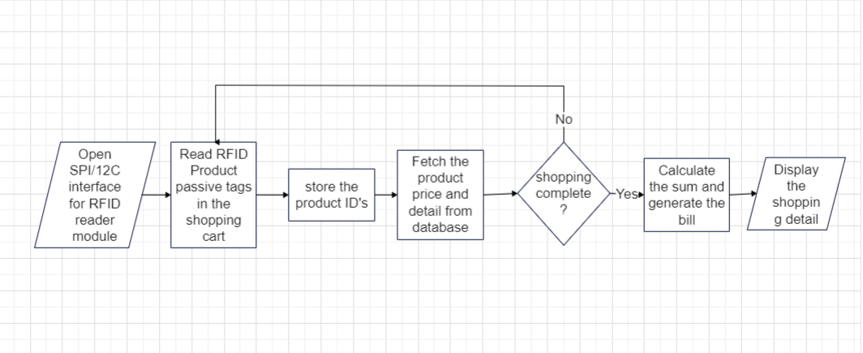
MODEL ARCHITECTURE

Slide 10
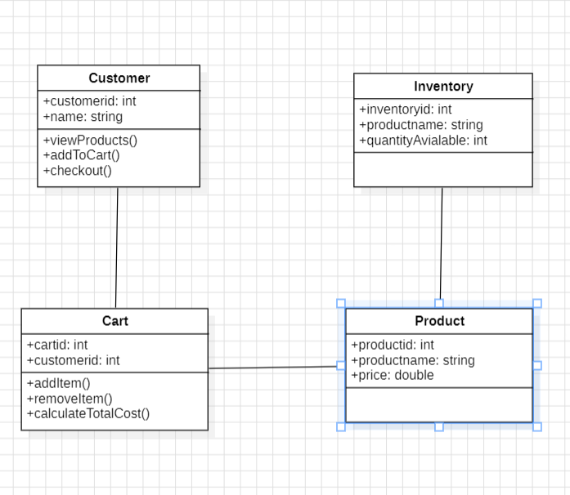
MODEL DESIGN
CLASS DIAGRAM

Slide 11
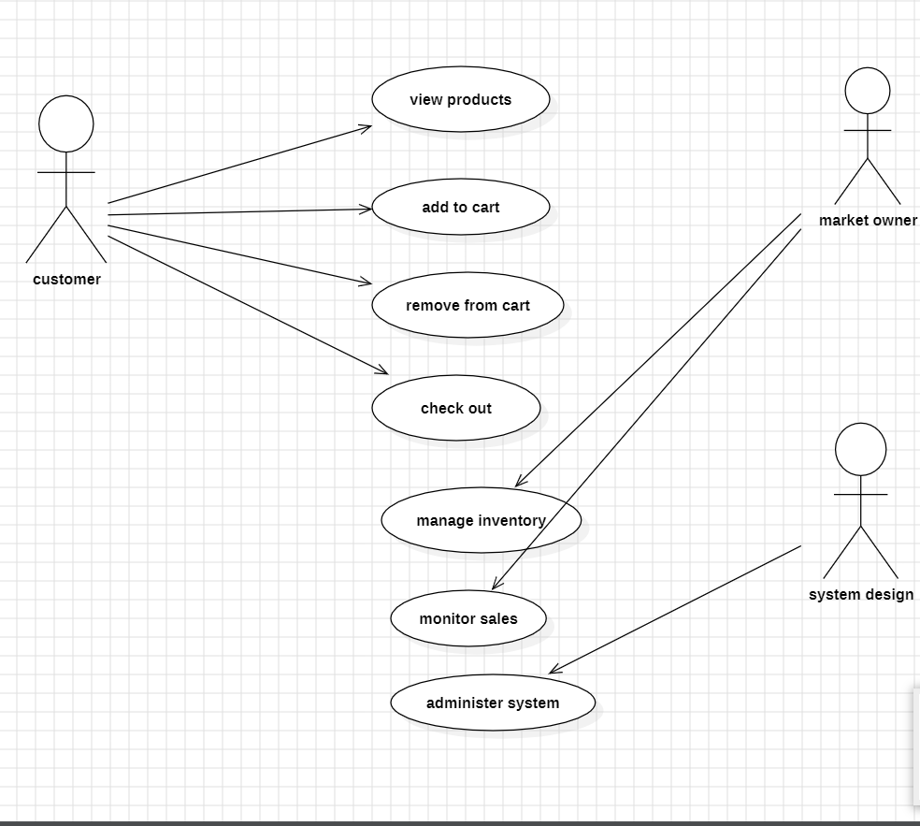
USE CASE DIAGRAM

Slide 12
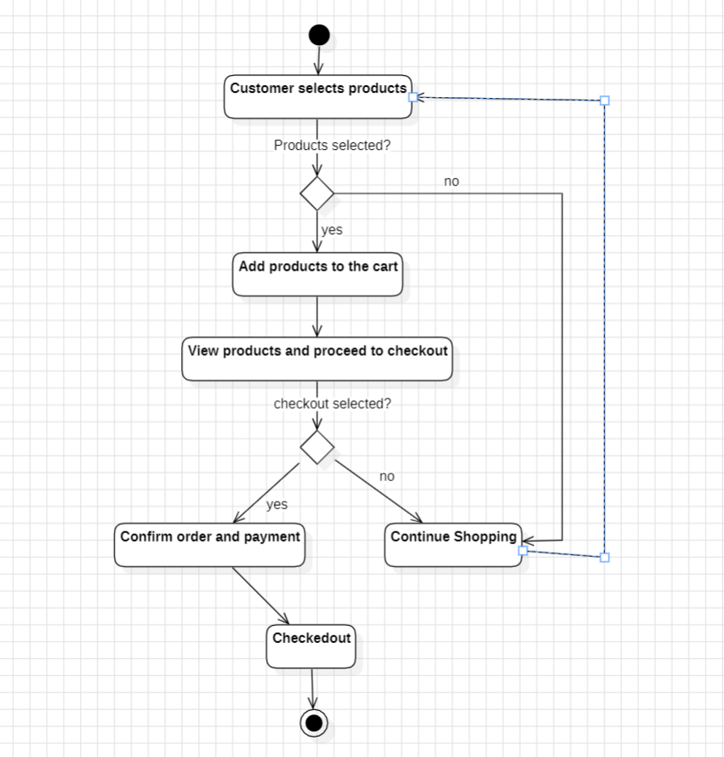
ACTIVITY DIAGRAM

Slide 13
IMPLEMENTATION
#include<ESP8266WiFi.h>
#include<WiFiClient.h>
#include<ESP8266WebServer.h>
#include<LiquidCrystal_I2C.h>
#include<Wire.h>
void printDetail(uint8_t type, int value);
LiquidCrystal_I2C lcd(0x3f, 16, 2);
const char* ssid = "justdo";
const char* password = "@12345";
ESP8266WebServer server(80);

Slide 14
String page = "";
char input[12];
int count = 0;
int a;
int p1 = 0, p2 = 0, p3 = 0, p4 = 0;
int c1 = 0, c2 = 0, c3 = 0, c4 = 0;
double total = 0;
int count_prod = 0;
int led1 = D5;
int led2 = D7;
int buzzer = D6;

Slide 15
void setup()
{
Serial.begin(115200);
pinMode(D4, INPUT_PULLUP);
pinMode(led1, OUTPUT);
pinMode(led2, OUTPUT);
pinMode(buzzer, OUTPUT);
Serial.begin(9600);
WiFi.begin(ssid, password);
Wire.begin(D2, D1);
lcd.begin();
lcd.backlight();
lcd.setCursor(0, 0);
lcd.print("WELCOME TO");

Slide 16
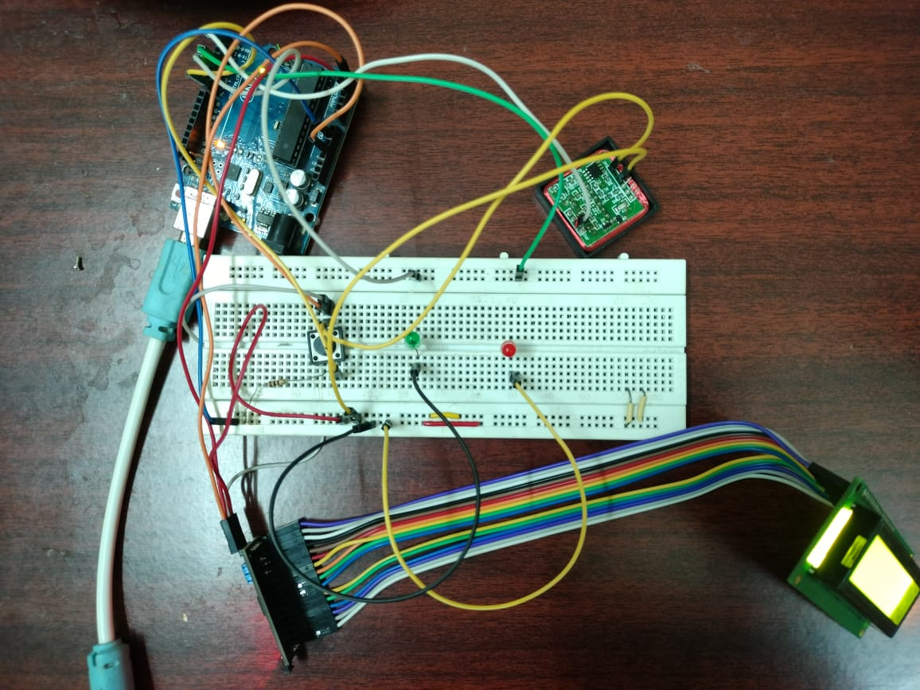
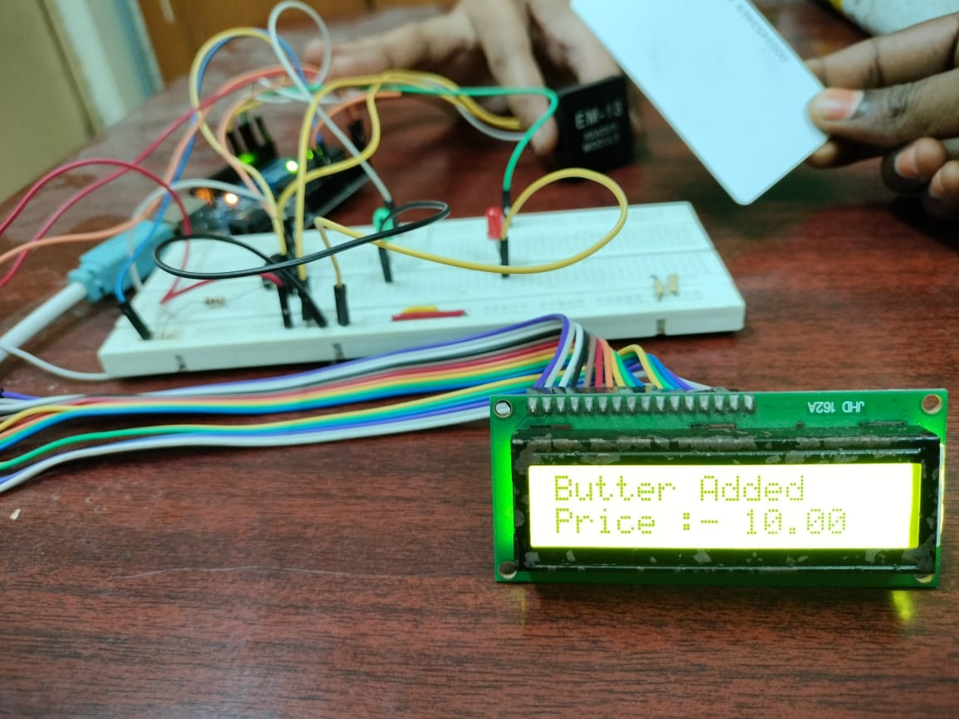
RESULTS

Slide 17
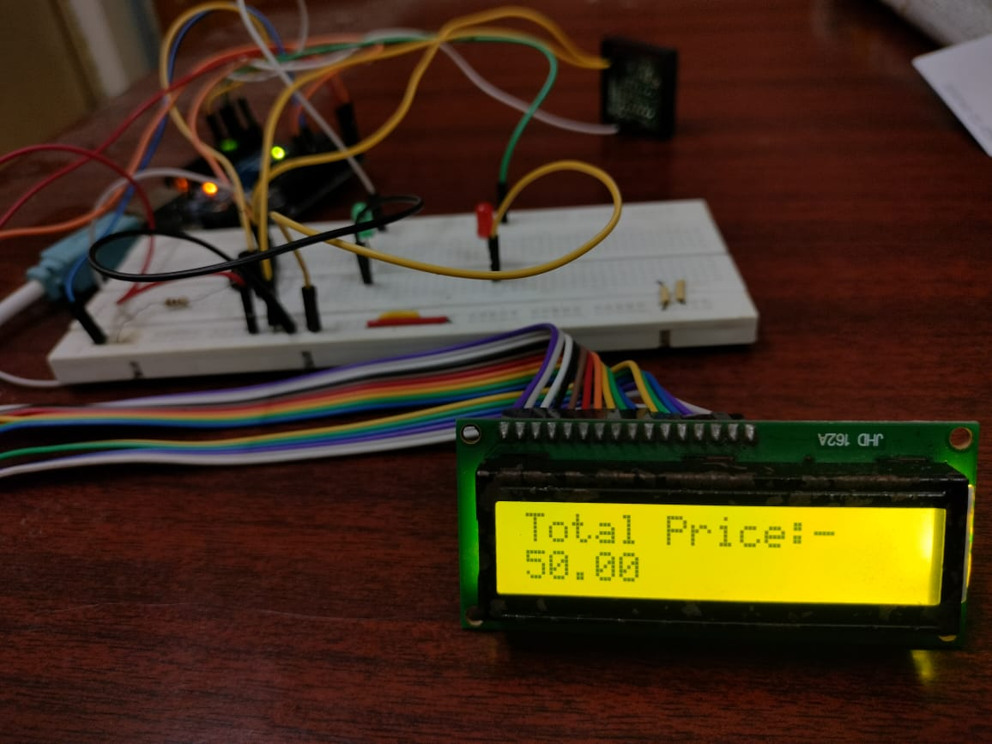

Slide 18
CONCLUSION
In conclusion, the proposed IoT-based shopping solution offers a significant improvement over the traditional shopping experience in markets. The proposed solution includes a smart billing system. In addition, future work for this solution includes integrating it with mobile apps, incorporating an AI-based recommendation engine, implementing real-time inventory management using IoT sensors, generating analytics and reporting, and integrating with online stores.

Slide 19
THANK YOU…

